Slide 1
Provider Orientation
2026 Medicaid

Slide 2
Agenda
Buckeye Health Plan Overview
Provider Resources
Provider Responsibilities
Provider Enrollment
Utilization Management
Claims, Adjustments and Appeals
Care Coordination/Care Management
Pharmacy/SPBM
OhioRISE
Contact Us

Slide 3
Buckeye Health Plan Overview

Slide 4
Buckeye’s Vision
Transforming the health of the community, one person at a time.
Buckeye Health Plan (Buckeye)* is a managed care health plan, providing services throughout Ohio since 2004. As a wholly-owned subsidiary of Centene Corporation, a leading multi-line healthcare enterprise offering both core Medicaid and specialty services, Buckeye coordinates comprehensive care for its members. Through its caring and compassionate associates, Buckeye serves the entire community with programs tailored to meet the unique needs of each individual.
Buckeye is living its vision statement by transforming the health of the community, one person at a time.
More than 900 Buckeye employees serve more than 300,000 members in the Medicaid, Medicare, and Marketplace products in Ohio. Now a $2 billion company, Buckeye is headquartered in Columbus, Ohio.
*Buckeye Health Plan operated as Buckeye Community Health Plan until September 2014.

Slide 5
Our Products/Plans
Medicaid
  Buckeye provides coverage to qualified adults and children; eligible aged, blind and disabled persons and children within the foster care program.
Marketplace
  Ambetter is a qualified health plan on the Ohio Health Insurance Marketplace. Member plan options vary between costs for monthly premium payments versus out-of-pocket expenses. Subsidies are dependent on member’s income level.
Medicare
  Our, Wellcare, Medicare product is offered through a comprehensive selection of Medicare plans across the state.
Next Generation MyCare (Combined Medicare and Medicaid)
  Beginning January 1, 2026, we launched an aligned Dual Special Needs Plan (D-SNP) in Ohio. As directed by Centers for Medicare & Medicaid Services (CMS), our current Medicare-Medicaid Plan (MMP), MyCare, sunset on December 31, 2025, and members were automatically transitioned into the new aligned D-SNP, Wellcare by Buckeye Health Plan.
  Like the MMP, this new plan is designed for individuals who qualify for both Medicare and Medicaid, allowing their benefits to be coordinated and managed by a single healthcare organization.

Slide 6
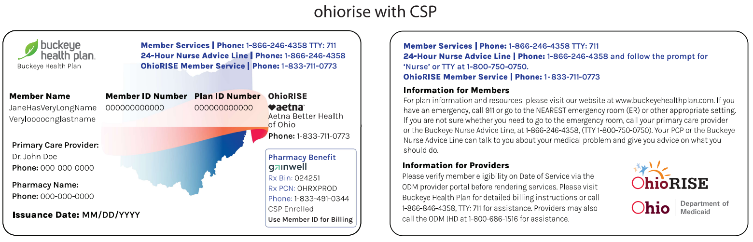
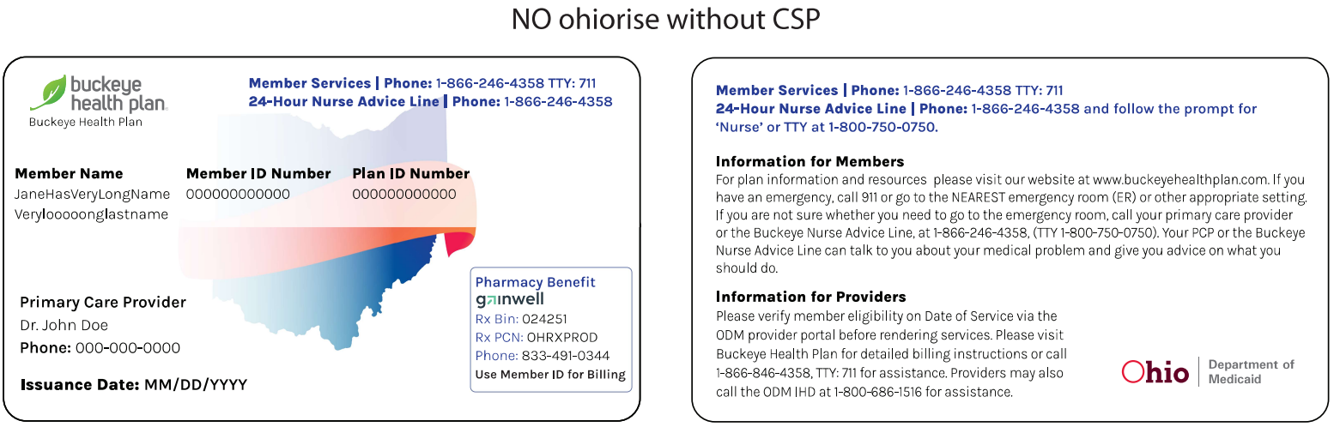
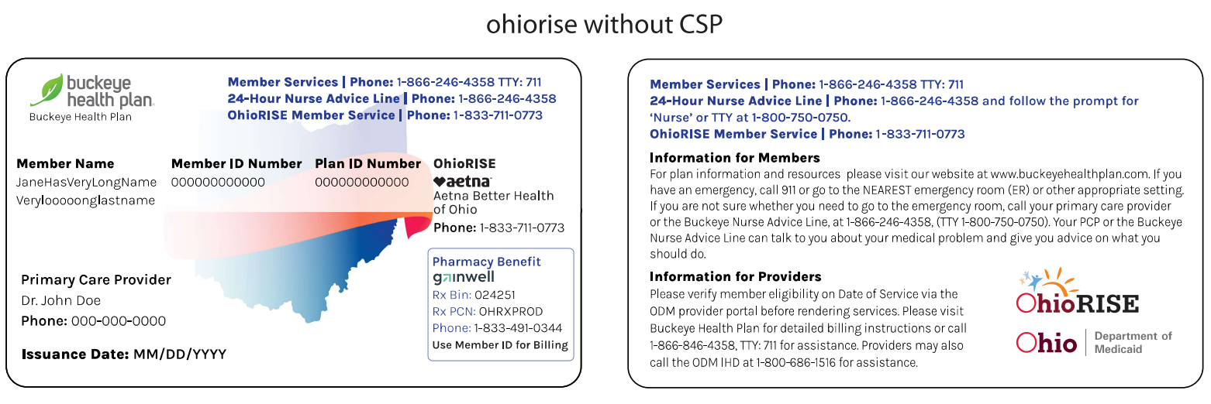
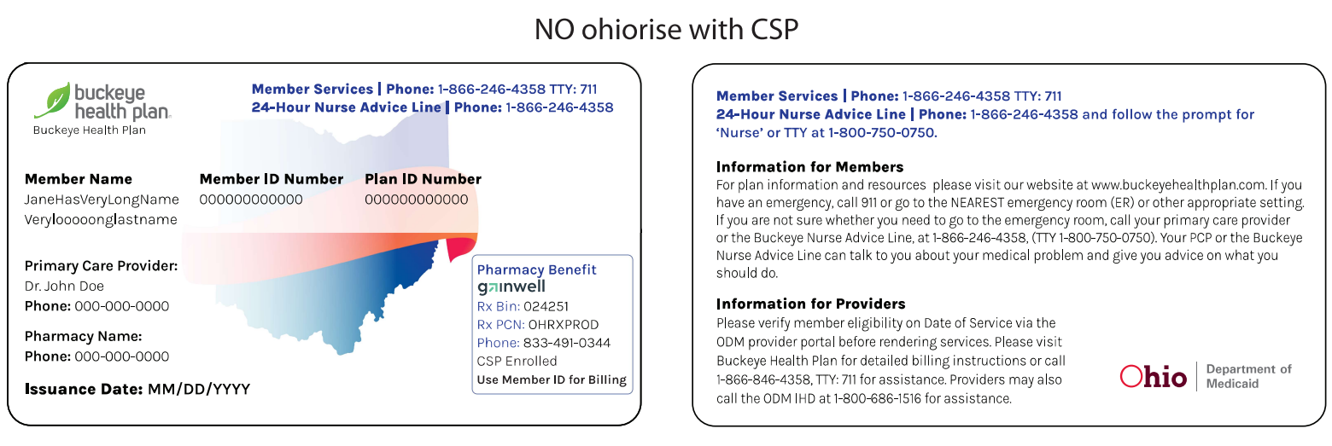
Medicaid Member ID Cards

Slide 7
Provider Resources

Slide 8

Buckeye Secure Provider Portal
Take care of business on YOUR schedule. The Provider Portal is yours to use 24 hours a day, seven days a week to accomplish several tasks.
Easily check member eligibility
View, manage, and download your member list
View and submit claims
View and submit service authorizations
Communicate with us through secure messaging
Maintain multiple providers on one account
Control website access for your office
View historical member health records
Submit assessments to provide better member care
And much more
Access the Secure Provider Portal from the Provider Home Page.

Slide 9
Availity Essentials
Buckeye Health Plan has chosen Availity Essentials as its new, secure provider portal. Starting January 20, 2025, providers can validate eligibility and benefits, submit claims, check claim status, submit authorizations, and access payer resources, via Availity Essentials.
Our current Secure Provider Portal is still available for other functions that providers use today.
For providers new to Availity Essentials, getting their Essentials account is the first step toward working with Buckeye on Availity.
  The provider organization’s designated Availity administrator is the person responsible for registering their practice in Essentials, managing user accounts, and should have legal authority to sign agreements for their organization.
  Administrators can Register and Get Started with Availity Essentials.
  Providers needing additional assistance with registration can call Availity Client Services at
  1-800-AVAILITY (282-4548), Monday through Friday, 8 a.m. – 8 p.m. ET.
  For general questions, providers can reach out to their health plan Provider Engagement representative.

Slide 10
Provider Services
Our Provider Services staff is your first stop in your quest for information. They are available to you and your staff to answer questions, listen to your concerns, assist with patients, respond to your Buckeye Plan inquiries, and connect you to your Buckeye Provider Engagement Administrator.
Provider Services hours of operation: Monday-Friday 7:00 a.m.-8 p.m. (EST)
Contact the Provider Services Toll Free Help Line at 866-296-8731.

Slide 11
Provider Engagement
Our Provider Engagement team is dedicated to making your experience with Buckeye a positive one by serving as your advocate within the organization. We are responsible for providing the services listed below which include but are not limited to:
Maintenance of existing Buckeye Provider Manual.
Network performance engagement.
Physician and office staff orientation.
Hospital and ancillary staff orientation.
Ongoing provider education, updates, and training.
The goal of this department is to furnish you and your staff with the necessary tools to provide the highest quality of healthcare to Buckeye enrolled membership.
You can find your assigned Provider Engagement representative by accessing our Provider Engagement page or reach out to Provider Services at 866-296-8731.

Slide 12
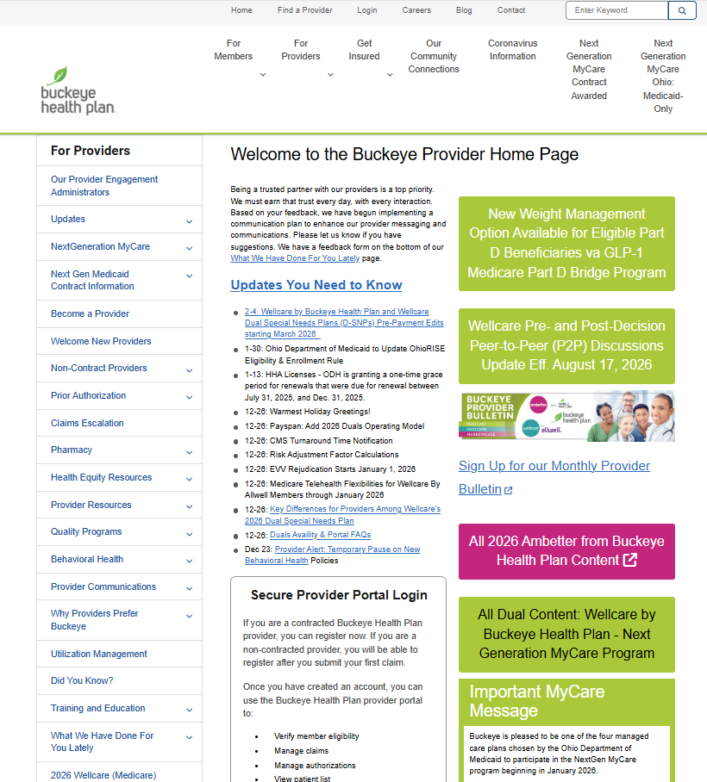
Provider Home Page
Our website Provider Home Page is a one-stop
shop to find access to information you need.
Latest updates on doing business with Buckeye.
Find-a-Provider search with mapping from member’s address
Provider manuals
Clinical guidelines
Online tool to verify prior authorization requirements
Downloadable forms including:
  Change of PCP
  Provider Action Request
  Member Connections

Slide 13
Website Resources
Join Our Network
Provider Portal
Find A Provider
Provider Manuals
Provider Trainings & Webinars
Forms
Pre-Auth Check
Provider Newsletters
Claims Payment System Error Notifications (CPSE)
Dispute-Appeals Process
Clinical & Payment Policies
Preferred Drug List
Pregnancy & Prenatal Information
Report Fraud, Waste and Abuse
www.buckeyehealthplan.com

Slide 14
Buckeye Key Information Highlights
Buckeye’s Provider Home Page provides links to key resources, provider updates, communications, and trainings.
Provider Resources are located via the lefthand side of the Provider Home Page.
  Provider Manuals
  Provider Newsletters
  Provider Training and Education
  Buckeye Pre-Auth Check tool
Dedicated Provider Services support:
Medicaid and MyCare Ohio 866.296.8731
Buckeye Contract Coordination: Ohiocontracting@centene.com
Contract Negotiators: OHNegotiators@centene.com

Slide 15
Provider Network Operations
Providers should submit updates to demographic data to OhioContracting@Centene.com within 30 days of the data change becoming effective.
Forms to add new practitioners can be found on our website and should be submitted along with all credentialing documentation to OhioContracting@Centene.com.
Enrollments are effective 30 days from the date all clean documents are received by Buckeye.
Please send the following items to OhioContracting@Centene.com:
Contract Clarification
Demographic information updates
Initiate credentialing of a new practitioner
Inquiries related to the status of a new practitioner or Join Our Network request

Slide 16

Provider Communications
We believe that communication is vital to a successful partnership and our goal is to communicate essential information, on a consistent basis, to earn your trust and make working with Buckeye easier.
Our newsletter is delivered electronically to all providers each month. This communication covers essential operational and procedural topics to help them do business with Buckeye. In addition, it delivers training and education opportunities and include some of Buckeye's provider-based initiatives. All editions of the newsletter will be available on the website.
Provider Communications Sign-Up
Whether you are an office manager, clinical staff, physician, billing or front desk worker, or serve in another role within our provider locations, Buckeye would like to share relevant, timely information that makes it easier to do business with us. Please sign up for Provider Communications. Even if you have received our email communications in the past, please sign up for future communications.

Slide 17
Provider Responsibilities

Slide 18
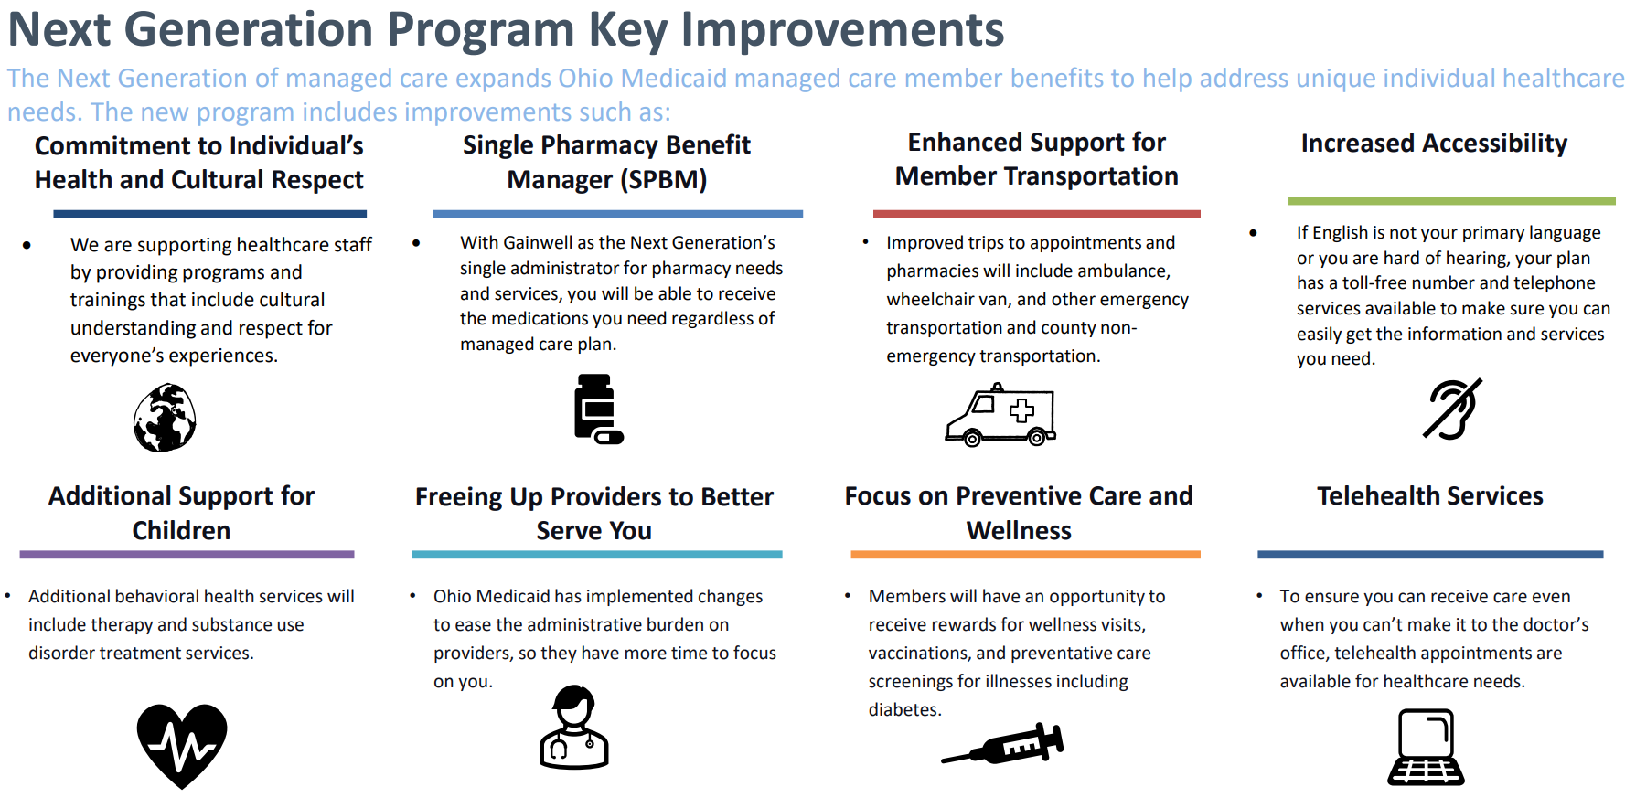
Next Generation Program Key Improvements
The Next Generation of managed care expands Ohio Medicaid managed care member benefits to help address unique individual healthcare needs. The new program includes improvements such as:
Notes:
Call out key improvements
Focus on the individual and wellness. Free up time for providers to better serve our members
And preventive care

Slide 19
Privacy, Covered Services & Access and Availability
Maintain the conﬁdentiality of members’ personal health information, including medical records and histories, and adhere to state and federal laws and regulations regarding conﬁdentiality.
Provide all covered physician services, including but not limited to telehealth in accordance with generally accepted clinical, legal, and ethical standards in a manner consistent with physician licensure, qualifications, training, and experience as outlined in the provider manual.
Maintain sufficient facilities and personnel to provide covered physician services and shall ensure that such services are available as needed 24 hours a day, 365 days a year in accordance with the appointment availability and access standards outlined in the provider manual.
Providers are required to develop and use telephone protocol standards as outlined in the provider manual and include After-hours availability.
Notes:
Reference provider manual for detail
Making tele-health available 24 hrs a day 365 days a year

Slide 20




Provider Appointment Standards for Scheduling
To ensure our members receive services for medical and behavioral health appointments in a timely manner, we ask providers to implement the following Appointment Availability Standards. These standards can also be found in your provider manual.
+ After Hours – All Providers
After Hours (Passing Standards)
Answering service or system that will page physician
Answering system with option to page physician
Advice nurse with access to physician
Answering service that will page the provider after a message is left
Emergency: Same day or within 24 hours of member’s call
SPECIALTY CARE
Emergency: Within 24 hours of member’s call
BEHAVIORAL HEALTH
Non-Life-Threatening Psychiatric Emergency: Within 6 hours
PRIMARY CARE
Urgent Care: 24 hours/7 days a week within 48 hours of request
Routine: Within 6 weeks of request
Sick Care: Within 3 calendar days
Urgent Care: 24 hours/7 days a week within 48 hours of request
Routine: Within 6 weeks of request
Urgent: 24 hours/7 days a week within 48 hours of request
Routine (Initial Assessment): Within 10 business days or 14 calendar days, whichever is earlier

Slide 21
Cultural Competency
Definition: Tailoring care and supports to meet the social, cultural, and linguistic needs of each patient.
Why It Matters: Diverse populations, those with limited English proficiency, and individuals with disabilities often face barriers to care and poorer outcomes.
Buckeye’s Approach:
Maintains a Cultural Competency Plan that monitors:
  Language services
  Transportation services
  Reasonable accommodations for members with disabilities
Shared Provider Responsibilities:
  Inform members of available services at no cost
  Provide diversity and cultural competency training to all staff
  Promote a diverse and inclusive workforce reflective of members served
Access Training & Attestation:
Available under Required Training on the Buckeye Provider Training & Education page.

Slide 22
Provider Enrollment, Credentialing & Contracting

Slide 23
PNM & Centralized Credentialing (1 of 2)
Centralized Credentialing
ODM has moved to a centralized model in which the agency will manage credentials, and providers need apply only once. Centralized credentialing eliminates the need to understand and comply with seven unique credentialing processes, easing the administrative burden felt by providers serving Ohio’s Medicaid members. In addition to standardizing the process and documentation that is collected, centralized credentialing helps eliminate repetitive work, improve revenue cycle, and lower credentialing costs for hospitals, facilities, providers, and practices.
Provider Network Management (PNM)
The PNM module is a part of a larger effort to modernize ODM’s management information systems. This modernization roadmap, developed in accordance with CMS guidance, includes a transition to a modular system called the Ohio Medicaid Enterprise System (OMES) that will support ODM in meeting several modernization goals. Ultimately, MITS will be retired.
PNM & Centralized Credentialing Capabilities
One Front Door for Provider Applications and Credentialing
Notes:
Very important to keep information on PNM up to date

Slide 24
PNM & Centralized Credentialing (2 of 2)
PNM & Centralized Credentialing training made available through Ohio Department of Medicaid
E-learning/On- Demand Trainings
Classroom Instructor-Led Training
Virtual Classrooms
Desk Reference Guides
Quick Reference Guide
Post Go-live Training
Additional information available at Ohio Department of Medicaid Provider Network Management Module (PNM) & Centralized Credentialing.
Notes:
If they have any questions- ODM conducted trainings that are also available at this link

Slide 25
Credentialing/Contracting
ODM is responsible for credentialing all Medicaid managed care providers. The credentialing and recredentialing processes are paired with enrollment and revalidation, respectively, in the Provider Network Management system.
Please note, you are not able to render services to Medicaid members until you are fully screened, enrolled, and credentialed (if required) by Ohio Medicaid. For a complete list of provider types that require credentialing, please refer to Ohio Administrative Code (OAC) rule 5160-1-42.
It is recommended that you begin the contracting process with each managed care organization (MCO) you wish to participate with while you are enrolling and being credentialed at ODM, in order to be able to render services as of your effective date. While the credentialing process is being centralized at the state Medicaid level, you are still required to contract with the MCOs.
When you submit your initial application to be an Ohio Medicaid provider, you can designate managed care organization interest in the PNM system. Once your application is submitted, demographic data for your provider is transmitted automatically to the MCOs so they can start contracting with you.
Notes:
Cannot load providers not listed on PNM
If you have not registered with ODM
We recommend you starting enrollment process at the same time.

Slide 26
Contracting
Upon initiating your enrollment application through the Ohio Department of Medicaid Provider Network Management (PNM) system, please follow the step-by-step instructions listed in our provider manual to submit your contract request to join our network of participating providers.
Access our Provider Home Page.
Select the “Become a Provider” in the left menu options.
On the Become a Provider page, select the appropriate form link in the Joining our Network section.
On the Join Our Network page, you will answer a series of questions.
To ensure provider information is loaded and maintained accurately, providers must continue to submit completed rosters or Provider Data Forms to OhioContracting@centene.com, with the exception of provider types 84 and 95. Forms are available on the Buckeye Health Plan website under Manuals, Forms and Resources > Forms.

Slide 27
Utilization Management

Slide 28
Prior Authorization
Prior Authorizations are required on some services and will continue to be submitted directly to the health plan until a later date to be determined by the Ohio Department of Medicaid.
To determine if a service needs prior authorization use our Prior Authorization Prescreen Tool.
If a service requires prior authorization, please note:
  Standard prior authorization requests should be submitted for medical necessity review at least five (5) business days before the scheduled service delivery date or as soon as the need for service is identified.
  Authorization requests should be submitted via our secure web portal and should include all necessary clinical information.
  Urgent requests for prior authorization should be called in as soon as the need is identified at 866-246-4359.
To submit a Prior Authorization for approval.
  Login to the Secure Provider Portal or Availity.
  Access the member’s record.
  Select the New Authorization option. The Authorization screen will appear with the member’s data pre-populated.
  Complete the Authorization Form.

Slide 29
Care Coordination/Care Management

Slide 30
Goals
Provide the best quality care for members by connecting with and tapping into the strengths of all the caregivers/entities working with the member.
Ensure our populations receive care and assistance to address needs and minimize future increase in risk.
Keep Members at the center of what we do.

Slide 31
Care Management
Accountable point of contact (care manager) identified who can help obtain medically necessary care, assist with health-related services and coordinate care needs. Multi-disciplinary team consisting of licensed individuals
Care management strategies: best-practice and evidence-based clinical guidelines; lower member/care manager ratios
Guidelines for frequency and intensity of contact with high-risk members
Face-to-face visits at point of care
Expected outcomes include optimization of member’s health; improved continuity of care coordination; decreased overall medical costs; decreased IP admits and ED visits
Care Management Referral Form

Slide 32
Care Coordination and Disease Mgmt.
Buckeye provides care coordination and disease coaching services for many conditions, such as asthma, diabetes, COPD, high-risk pregnancy and many more.
Start Smart for Your Baby®
  An incentive for pregnant mothers to encourage them to keep their prenatal appointments.
  Start Smart Education offers education information and education forums to pregnant members and parents.
  Identifies pregnant women that are medically high risk and assigns them a Care Manager to assist them through their pregnancy to a successful delivery.
  Perinatal Risk Assessment Form incentive program
The provider’s role in Buckeye Health Plan's Care Coordination program is extremely important. Practitioners who have identified a member who they think would benefit from disease or care management should contact the Care Coordination Department to speak with a member of our Integrated Care Team at 866-246-4358 or submit a
Care Management Referral Form.

Slide 33
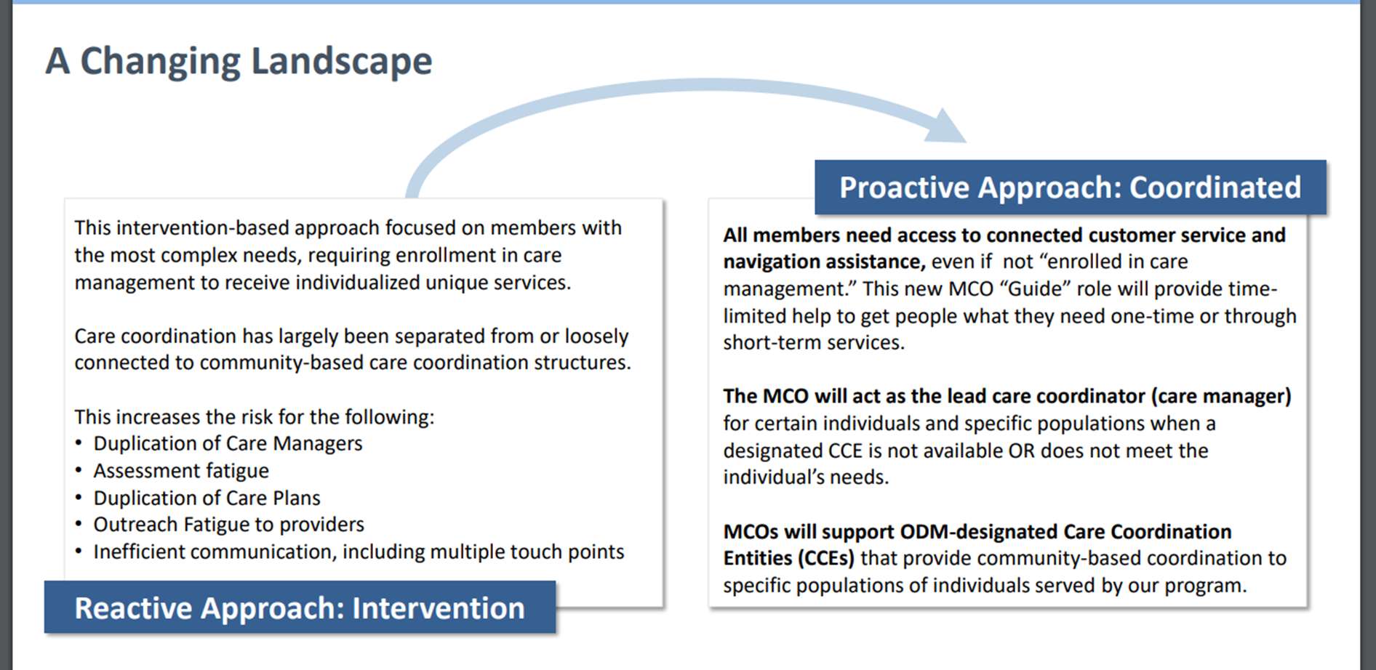
Care Coordination and Disease Mgmt.
Notes:
Previously we have a reactive approach and now moving to proactive
Keeping member at center of everything that we do
Care managers will work and make sure all needs are met and work will all entities to c ordinate care to our members.

Slide 34
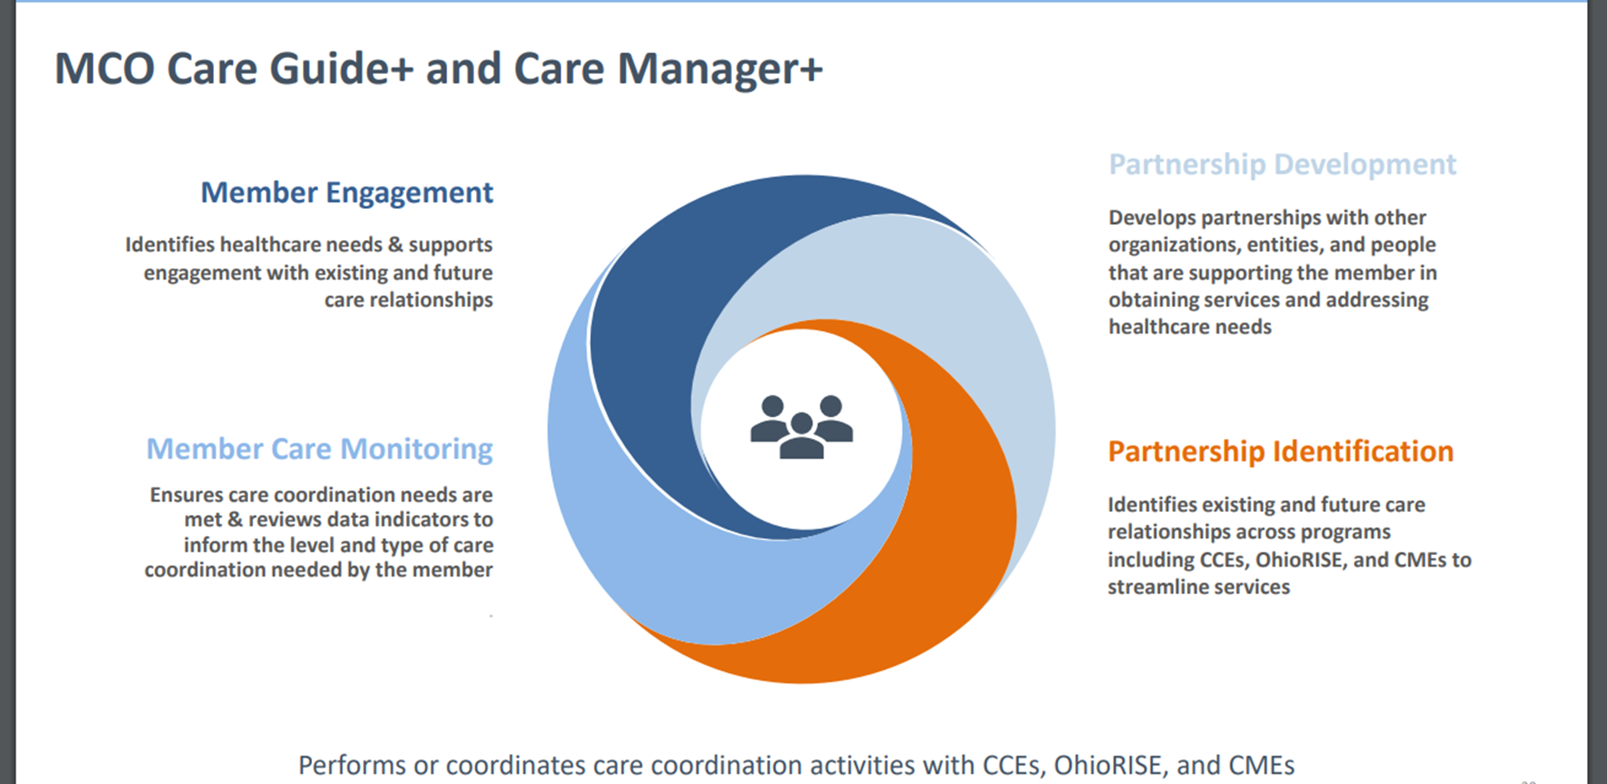
Care Coordination and Disease Mgmt.

Slide 35
Care Coordination
Care Guide/Care Guide +
Short term needs 60 days or less
Event driven coordination i.e., emergency room visit or inpatient admission.
One IP admission or ER visit in past 30 days.
Pregnant with no Notification of pregnancy on file.
Care Manager/Care Manager +
Long term needs greater than 60 days.
Treatment driven coordination such as a chronic condition.
Recent admission within 30 days of newly diagnosed chronic condition
Member with behavioral and physical health needs.
Referrals: Buckeye_Care_Coordination_Escalations@CENTENE.COM
Notes:
Mention email address

Slide 36
Claims, Adjustments and Appeals

Slide 37
Fiscal Intermediary
The Fiscal Intermediary is a part of a larger effort to modernize ODM’s management information systems. This modernization roadmap, developed in accordance with the Centers for Medicare and Medicaid Services (CMS) guidance, includes a transition to a modular system called the Ohio Medicaid Enterprise System (OMES) that will support ODM in meeting several modernization goals. As a part of this roadmap, updated and new functionality - such as Fiscal Intermediary - is being built into OMES rather than MITS.
Fiscal Intermediary Capabilities
One Door for Prior Authorization Submissions (whether PNM or EDI) for all lines of business. * FFS Medicaid only at this time
One Door for Claims Submissions (whether PNM or EDI) for all lines of business and effective 2/1/2023 will include MCEs
One Door for Recipient Eligibility Look-Up (whether PNM, EDI, or IVR) for all lines of business. * FFS Medicaid only at this time
Additional functionality that exists in MITS today that will continue in PNM in the future: FFS Medicaid only at this time
  Cost Report Submission
  Ability to upload attachments for Prior Authorizations and Claims
*Refers to managed care / OhioRISE. MyCare prior authorizations will not be coming in Medicaid’s front door. Providers will continue to submit those prior authorizations to the managed care plans until a later date TBD.
Additional information available at Ohio Department of Medicaid Fiscal Intermediary.
Notes:
But only in place for claims as of 2/1/23
Under next gen agreement the FI is set up
For the MCP as of 2/1/23 the FI will be responsible for claims only at this time.

Slide 38
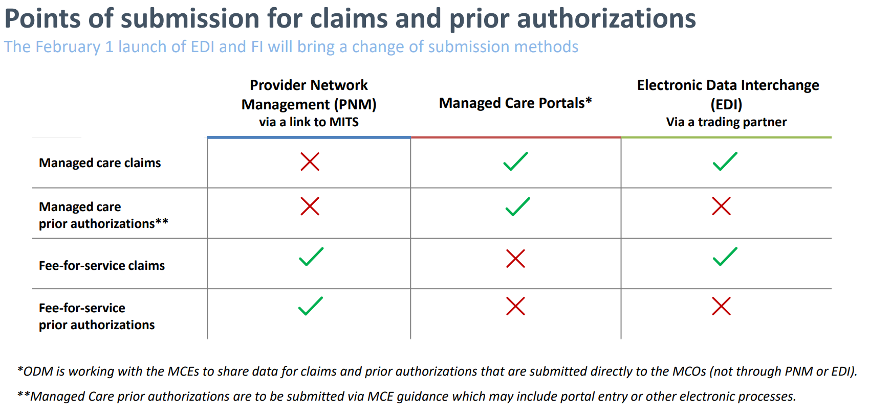
Claims Submission (1 of 4)
Effective February 1, 2023

Slide 39
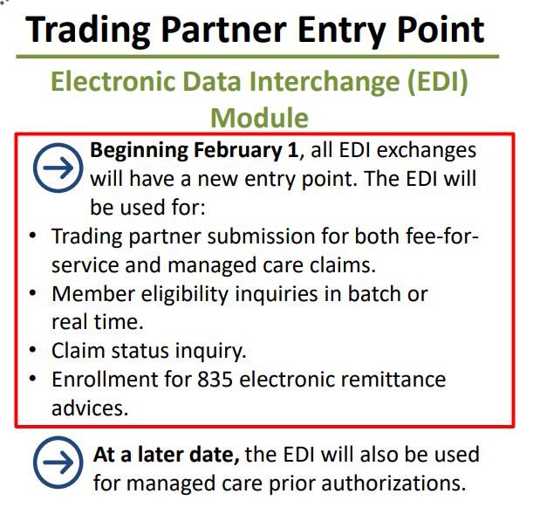
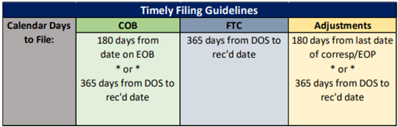
Claims Submission (2 of 4)
Billing Methods
Buckeye accepts claims in a variety of formats, including electronic EDI through FI, Portal Direct Data Entry, and paper claims.
  Fiscal Intermediary
Claim Submission Time Frame per OAC 5160-1-19.
Coordination of Benefits (COB), First Time Claims (FTC), and Adjustments
Effective February 1, 2023
Notes:
There are several ways in which Buckeye Claims can be billed
At a later date PA will also go through FI TBD
FTC- First time claims

Slide 40
Claims Submission (3 of 4)
DOS Prior to 2/1/2023 Electronic Claims Submission Medical Payor ID 68069
DOS Prior to 2/1/2023 Electronic Claims Submission Behavior Health Payor ID 68068
Visit: Provider Home Page > Click Provider Resources/Electronic Transactions (EDI)
Effective for DOS 2/1/2023 and after New Buckeye
Payer IDs:
  0004202 BUCKEYE OHIO MEDICAID (837 P & I ONLY)
  V004202 BUCKEYE/ENVOLVE VISION
  D004202 BUCKEYE/ENVOLVE DENTAL (837 Dental)
Electronic Claims Submission
  EDI department: 1-800-225-2573, ext. 25525 or via e-mail at: EDIBA@centene.com
Portal Claims submission can be entered by logging on to the Secure Provider Portal or Availity.
Paper Claims Submission
Medicaid Medical claims:
Buckeye Health Plan
PO Box 6200
Farmington, MO 63640
Medicaid Behavioral Health Claims:
Ohio Claims Behavioral Health
PO Box 6150
Farmington, MO 63640
Notes:
Electronic Claims submitted after DOS after 2/1/23 can be submitted using the new pater ID’s listed below
For EDI questions and concerns,
Paper claims can also be submitted for Medical and Behavioral health at the addresses listed below

Slide 41
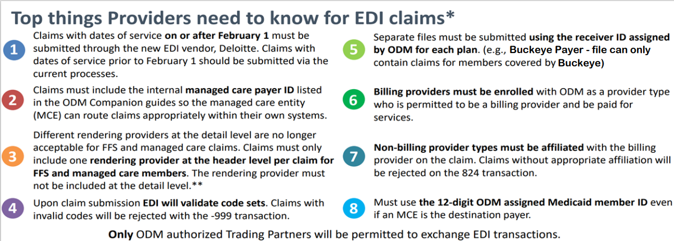
Claims Submission (4 of 4)
Please see the ODM Companion Guides for specific instructions and additional guidance.
*MyCare claims and prior authorizations will not be coming through the Ohio Medicaid Enterprise System (OMES).
Providers will continue to submit those claims and prior authorizations to the MyCare managed care plans.
**Exceptions for FFS Federally Qualified Health Centers (FQHC) and Rural Health Clinics (RHC) providers are detailed at http://Medicaid.ohio.gov/static/About+Us/PoliciesGuidelines/MAL/MAL622-A.pdf
Notes:
Must be enrolled with ODM to
Non billing providers must be

Slide 42
Claim Dispute Resolution
Provider claim disputes are any provider inquiries, complaints, or requests for reconsiderations ranging from general questions about a claim to a provider disagreeing with a claim denial.
Providers are required to file a written claim dispute no later than 12 months from the date of service or 60 calendar days after the payment, denial, or partial denial of a timely claim submission, whichever is later.
A dispute is received verbally and/or in writing by the Buckeye Provider Services Call Center (PS), Buckeye Medical Appeals Coordinator or other Buckeye staff, and Corporate Claims Department.
Dispute process
Buckeye will provide written notice to the provider of the disposition of all claim disputes once a resolution has been determined. Written notice will not be sent if the claim dispute was resolved with an initial phone call or in-person contact.
The dispute will be reviewed by the area responsible for processing to ensure the dispute was received within the appropriate timeframe.
Once a resolution has been determined for each claim dispute, Buckeye will reprocess and uphold or pay the associated claim as needed within 30 days from written notice of resolution.
Notes:
More details in this regard can be found on our website

Slide 43
Claim Dispute Resolution
Buckeye will thoroughly investigate each provider claims dispute using applicable statutory, regulatory, and contractual provisions, collecting all pertinent facts from all parties, and applying BHP’s written policies and procedures.
A letter will be sent to the provider notifying them of the disposition of the dispute review within 15 days of receipt.
  If additional time to resolve a dispute is needed past 15 business days, Buckeye will provide the dispute status on the Provider Portal which can be accessed at any time by the provider.
  Buckeye will re-process and pay disputed claims, when the resolution determines they were paid/denied incorrectly, within 30 calendar days of the written notice of the resolution unless a system fix is needed then additional time is allotted.
  Buckeye will automatically apply the corrective action or claims resolution to correctly adjudicate all other provider claims affected by the same issue.

Slide 44
Pre-Service Appeals (1 of 5)
A pre-service appeal is the request for review of a “Notice of Adverse Action.” A “Notice of Adverse Action” is the denial or limited authorization of a requested service, including the:
  Type or level of service.
  Reduction, suspension, or termination of a previously authorized service.
  Denial, in whole or part of payment for a service excluding technical reasons.
  Failure to render a decision within the required timeframes.
  Denial of a member’s request to exercise his/her right under 42 CFR 438.52(b)(2)(ii) to obtain services outside the Buckeye Health Plan network.
Standard appeal decisions are issued within 10 days from date of receipt of the appeal request.
Expedited appeal decisions are issued as expeditiously as the member’s health condition requires, to not exceed 48 hours from the initial receipt of the appeal.
Who Can File a Pre-Service Appeal?
For pre-service member appeals, members or an authorized representative of a member may appeal an adverse determination. This can be the member, doctor, or other service provider like a physical therapist. Written consent is required if provider is appealing on behalf of the member or assisting member in the appeals process. If you are assisting a member to file a pre-service appeal, please go to This is considered a pre-service member appeal.
If you are assisting a member to file a pre-service appeal, please go to Appointing a Representative for more details.
A practitioner with knowledge of the member’s condition may request an expedited appeal on a member’s behalf. Written member consent is not required for expedited appeals requested by the provider. Providers may also submit a request for an expedited appeal by phone or fax.
For pre-service provider appeals, requesting providers can appeal on their own behalf without written consent from the member.
Notes:
Call out time frames- we now only have 48 hours
Now only have 10 days
Who can file an appeal

Slide 45
Pre-Service Appeals (2 of 5)
Expedited appeal decisions are issued as expeditiously as the member’s health condition requires, to not exceed 48 hours from the initial receipt of the appeal.
Expediting pre-service appeal is when either Buckeye Health Plan or the member’s provider determines that the time expended in a standard resolution could seriously jeopardize the member’s life or health or ability to attain, maintain, or regain maximum function. No punitive action will be taken against a provider that requests an expedited resolution or supports a member’s appeal. If the request for expedited appeal is denied, the appeal must be transferred to the timeframe for standard appeal resolution.
14 Calendar Day Extension may be added by Buckeye is applied for both standard and expedited pre-service appeals:
If the member requests the extension, or
If Buckeye provides evidence satisfactory to the Department of Health Services (DHS) that a delay in rendering the decision is in the member’s interest.
For any extension not requested by the member:
  Buckeye will provide written notice of the reason for delay to the member.
  Buckeye will make reasonable efforts to provide the member with prompt verbal notice of any decisions not resolved wholly in favor of the member and will follow-up in writing within two calendar days of action.
Notes:
Call out time frames- we now only have 48 hours
Now only have 10 days
Who can file an appeal

Slide 46
Pre-Service Appeals (3 of 5)
What are the Timeframes?
The timeframe to file a standard appeal is no longer than 60 calendar days from the day following the mailing date of Buckeye’s notification of adverse determination of the requested service.
An expedited appeal is available for Medicaid members when the service is needed more quickly and for all urgent care requests. These expedited appeal decisions and notification will be no later than 48 hours after the appeal request is received by Buckeye.
Therefore, it is important that if this type of request is made all documentation should be in order.
Expedited appeals are not available for post-service requests.
REMEMBER: If an appeal is not filed in the timeframe outlined above, a request can be made to appeal but must be in writing and include information as to why the request was not submitted timely.
Helpful Tip
Always remember the documentation is KEY and should include records and other information relevant to the decision and especially address the reason it was denied.
Notes:
Call out time frames- we now only have 48 hours
Now only have 10 days
Who can file an appeal

Slide 47
Pre-Service Appeals (4 of 5)
How to Submit Pre-Service Provider Appeals
Pre-Service Provider appeals can be submitted to Buckeye Health Plan through the following methods:
Online: Provider Portal (This is the most efficient method. Please see the next slide for the portal filing instructions for pre-service appeals.)
Phone: 1-866-246-4358 (TTY: 711)
Fax: 1-866-719-5404
Mail:
Buckeye Health Plan
4349 Easton Way, Suite 120
Columbus, OH 43219
Pre-Service appeals do not include anything that has a claim that has already been submitted to BHP and has been paid or denied accordingly.
If a claim has already been submitted, please submit a claim dispute. The provider manual can be referenced for additional claim dispute information.
Notes:
Call out time frames- we now only have 48 hours
Now only have 10 days
Who can file an appeal

Slide 48
Pre-Service Appeals (5 of 5)
Provider Portal Filing Instructions
Login to Provider Portal.
  New users can create new account to establish portal access. Go to the Create Account page.
Select the appropriate Plan Type (Medicaid) and TIN Number.
Find an eligible member, select authorizations by clicking on the Authorizations tab from the top header of the page or the members overview page.
  Authorization page will show a list of authorizations for that member with different status (Example: Approve / Pended / Deny).
  Authorization Appeal cannot be created for Pending Authorizations.
Click on an authorization number to show the Authorization details page which displays:
  Details of the authorization
  List of appeals created for the same authorization number at the bottom of the page along with its status type and other details. Clicking on the ‘Request ID’ of the appeal will show details of the appeal along with its status.
  ‘Request Appeal’ button to create a new appeal.
Then, click the “Request Appeal” button to display an Appeal Request form.
On the Appeal Request Form, all fields must be completed.
  Field ‘Appeal type’ requires either Medical or Administrative or both to be selected.
  Rationale is required and has a limit of 2000 characters.
  Documents must be attached using the “Evidence Materials and Attachment” section.
After all required fields are completed, click the “Save & Review Appeal” button at the bottom to review all appeal information are correct before submission.
Select the “Send Request” button at the bottom of the review page. On successful submission, users will be redirected back to the Authorization details page with new appeal being added to the list.
To view the status of your submission, click on the appeal reference number (Request ID) on the Authorization details screen to display Appeal details page.
If you have questions, please contact Provider Services at 866-296-8731.
Notes:
Call out time frames- we now only have 48 hours
Now only have 10 days
Who can file an appeal

Slide 49
Pharmacy

Slide 50
Single Pharmacy Benefit Manager (SPBM)
The Single Pharmacy Benefit Manager (SPBM) is a specialized managed care program operating as a prepaid ambulatory health plan (PAHP) that will provide pharmacy benefits for the entire Medicaid Managed Care population (excluding MyCare members). ODM has selected Gainwell Technologies to serve as the SPBM.
An additional integral component to the new pharmacy model is the Pharmacy Pricing and Audit Consultant (PPAC), which will conduct actual acquisition cost surveys, cost of dispensing surveys, and perform oversight and auditing of the SPBM. ODM has selected Myers and Stauffer, LLC as the PPAC vendor.
The SPBM will consolidate the processing of retail pharmacy benefits and maintain a pharmacy claims system that will integrate with the Ohio Medicaid Enterprise System (OMES), new MCOs, pharmacies, and prescribers. The SPBM also will work with pharmacies to ensure member access to medications, supporting ODM’s goals of providing more pharmacy choices, fewer out-of-network restrictions, and consistent pharmacy benefits for all managed care members. SPBM will also reduce provider and prescriber administrative burden, by utilizing a single set of clinical policies and prior authorization procedures, as well as a single pharmacy program point of contact for all members.
Additional information is available at Ohio Medicaid Single Pharmacy Benefit Manager (SPBM).
Notes:
Remeinder- in October Medicaid moved to this

Slide 51
OhioRISE

Slide 52
OhioRISE
(Resilience through Integrated Systems and Excellence)
A specialized managed care program for youth with complex behavioral health and multi-system needs.
Specialized Managed Care Plan
Aetna Better Health of Ohio will serve as the single statewide specialized managed care plan.
Shared Governance
OhioRISE features multi-agency governance to drive toward improving cross-system outcomes – all we all serve many of the same kids and families.
Coordinated and Integrated Care & Services
OhioRISE brings together local entities, schools, providers, health plans, and families as part of our approach for improving care for enrolled youth.
Prevent Custody Relinquishment
OhioRISE will utilize a new 1915c waived to target the most in need and vulnerable families and children to prevent custody relinquishment.
Additional information is available at OhioRISE (Resilience through Integrated Systems and Excellence).
Aetna Better Health of Ohio can be reached by calling 833-711-0773 or e-mailing OHRISENetwork@aetna.com.
Notes:
BCP works closely
We are still responsible to medical portion of benefits .
Contact us and questions

Slide 53
OhioRISE
Community and Provider Training
Trainings were facilitated jointly by ODM, Aetna Better Health of Ohio, the Child and Adolescent Behavioral Health Center of Excellence (COE) and state agencies and helped community partners and providers prepare for implementing this important program in July 2022. Each session covered a range of topics including OhioRISE implementation, systems, and operations.
OhioRISE community and provider training modules were presented live, and the recordings are available on the OhioRISE Community and Provider Training page. Additionally, office hours were with OhioRISE subject matter experts.
ODM encourages all community partners and providers who will deliver OhioRISE services and supports to OhioRISE-enrolled youth and their families to view each module, as applicable, at the OhioRISE Community and Provider Training link below. Please direct OhioRISE provider training inquiries to OhioRISE@medicaid.ohio.gov.
Additional information is available at the OhioRISE Community and Provider Training.

Slide 54
OhioRISE
The CANS Assessment
What is a CANS Assessment?
The Child and Adolescent Needs and Strengths (CANS) is a functional assessment tool that:
Assesses both child and family needs and strengths.
Provides decision support to identify appropriate approaches.
Used to make OhioRISE program eligibility determinations.
Used to support OhioRISE care planning.
There are two type of CANS Assessments
Brief CANS:
  Used as an ‘initial’ assessment…..
  Includes core items to determine eligibility, tier of care coordination, qualified residential treatment program (QRTP) level of care (LOC), recommendations for care.
Comprehensive CANS:
  Used for ‘ongoing’ assessments – expands items in Brief CANS to improve care planning and coordination
    (Could be used at time of initial assessment if preferred by assessor)
  Additional modules are triggered by responses on specific items, such as sexually problematic behavior, runaway, adjustment to trauma.

Slide 55
OhioRISE
CANS Resources
The new OhioRISE program will use the Ohio Children’s Initiative Child and Adolescent Needs and Strengths (CANS) tool to establish eligibility. The CANS was developed with leadership from Governor DeWine’s Children’s Initiatives and Ohio’s child-serving state agencies and is used by a wide variety of providers to inform care planning and decision-making for children and adolescents with behavioral health needs. Certified Ohio Children’s Initiative CANS assessors are expected to use the CANS to gather all information about the child/youth and family story to describe their strengths and needs.
Visit Child and Adolescent Needs and Strengths Resources for more information regarding the CANS tool.
How to Obtain Ohio Children’s Initiative CANS Certification
Billing for CANS Assessments
CANS IT System Training
Access the CANS IT System
Contacts for Support

Slide 56
Contact Buckeye

Slide 57


Contact Us
Our helpful Provider Services representatives are available to take your call at 866-296-8731 Monday through Friday from 7 a.m. to 8:00 p.m.
Send a secure message on our portal:
Log in to the portal.
Select “Message” from the top banner.
Complete your message. Allow 3 to 5 business days for a reply.

